Slide 1
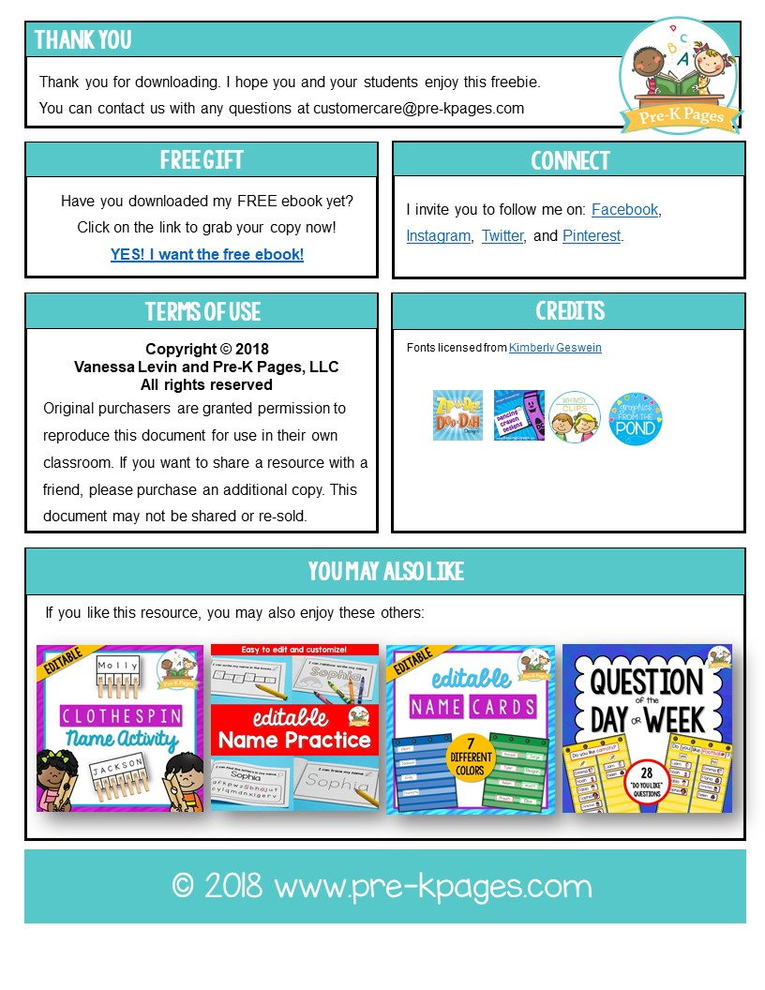
©2018 www.pre-kpages.com

Slide 2
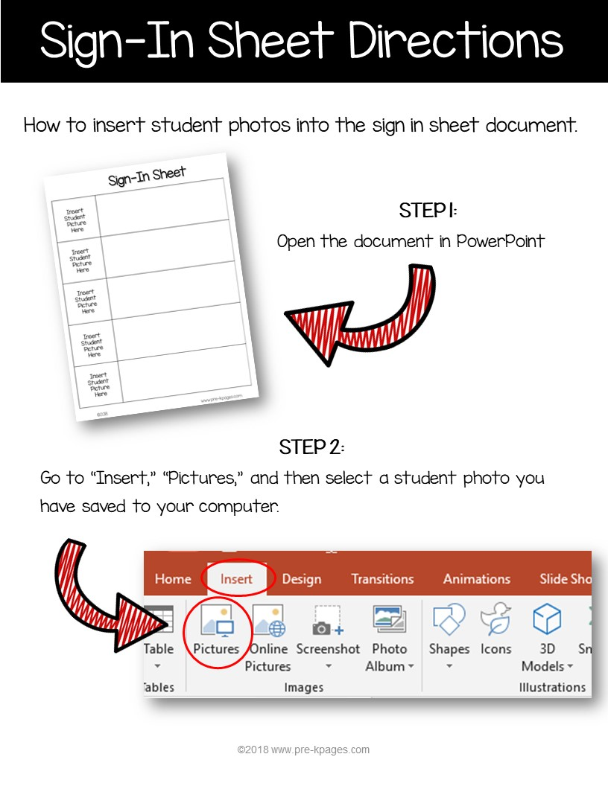
©2018 www.pre-kpages.com

Slide 3
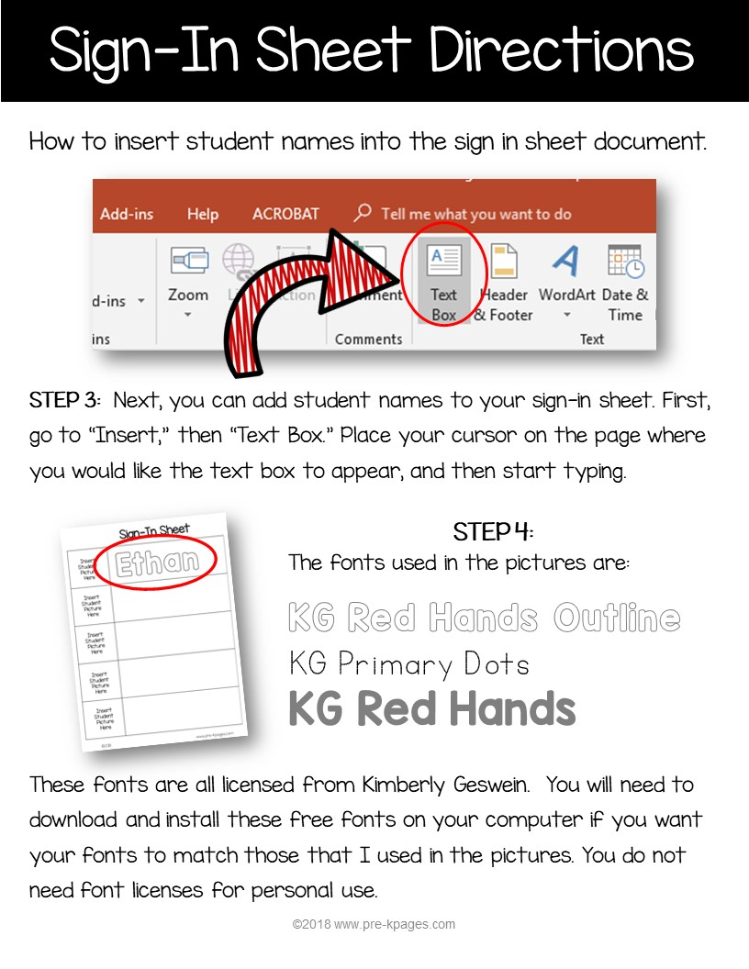
©2018 www.pre-kpages.com

Slide 4

Type your own text here
Insert
Student
Picture
Here
Type Student Name Here
Insert
Student
Picture
Here
Type Student Name Here
Insert
Student
Picture
Here
Type Student Name Here
Insert
Student
Picture
Here
Type Student Name Here
Insert
Student
Picture
Here
Type Student Name Here
©2018 www.pre-kpages.com

